Slide 1
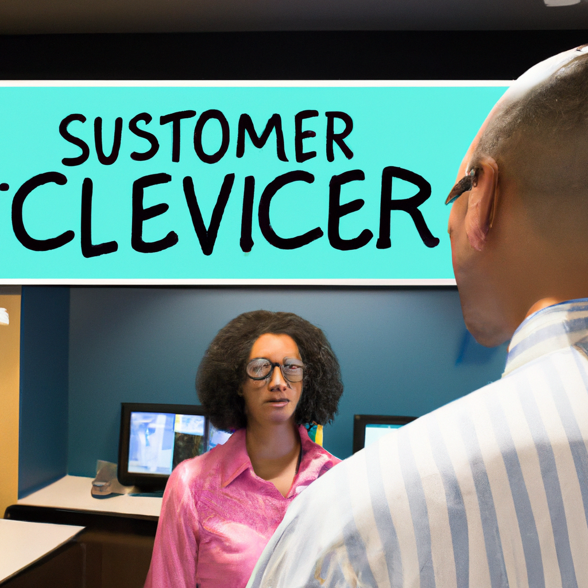
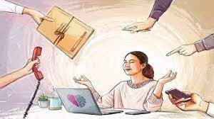

Slide 2
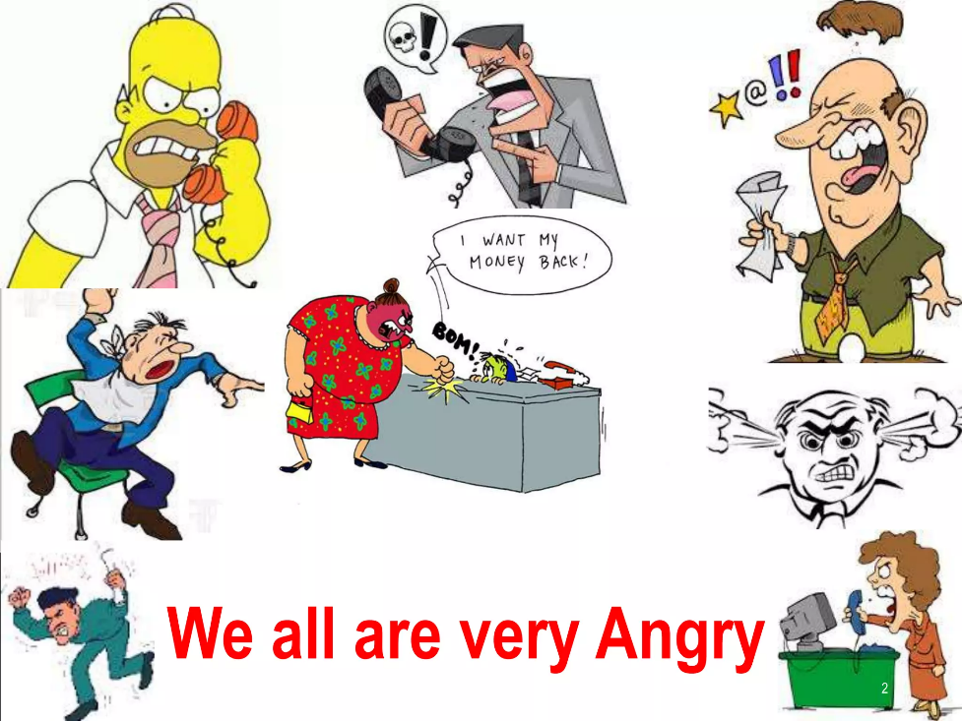
Project Title: Steps to Deal with Angry Customer | Screen Title: Introduction | Screen No: 2
 |  | Graphic Info: Animate this picture into the screen while the narrator is speaking.
 |  | Navigation: On the bottom of this page, put the arrow button to navigate the course
 |  | Reviewers Comments:
Text/Audio: Welcome, everyone, to today's training on 'Steps to Deal with Angry Customer.' In this session, we'll explore essential strategies to effectively handle challenging customer interactions. As businesses, we all know that dealing with angry customers is a reality we may encounter at any time. How we respond in these situations can make a significant difference in our customers' satisfaction and our overall business success.

Slide 3
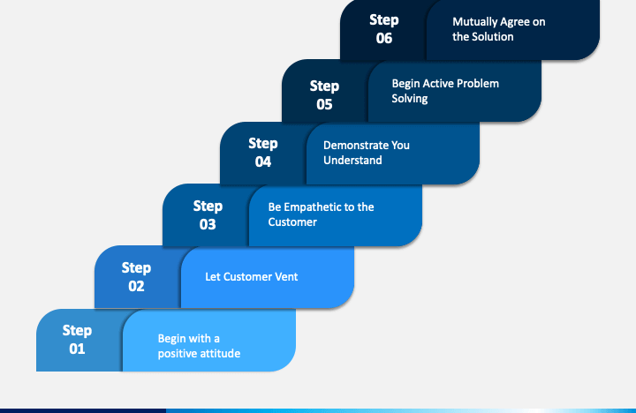
Project Title: Steps to Deal with Angry Customer | Screen Title:Steps to Deal with Angry Customer | Screen No: 3
 |  | Graphic Info: Animate this picture into the screen while the narrator is speaking.
 |  | Navigation: On the bottom of this page, put the arrow button to navigate the course
 |  | Reviewers Comments:
Text/Audio: By mastering these steps, you will not only retain valuable customers but also enhance your own confidence in dealing with challenging situations. Conversely, mishandling angry customers can lead to lost opportunities, negative reviews, and damaged reputations. Unresolved conflicts may result in customer churn, impacting our bottom line. Therefore, it is crucial for all of us to equip ourselves with the right tools and techniques to handle these situations with tact, empathy, and professionalism. Each step addresses crucial aspects of dealing with angry customers, including maintaining composure, active listening, offering genuine apologies, and finding suitable solutions.

Slide 4

Project Title: Steps to Deal with Angry Customer | Screen Title: Scenario (Angry Customer) | Screen No: 4
 |  | Graphic Info: Animate this picture into the screen while the narrator is speaking. (A contrasting images—one with an angry customer and another with a composed employee)
 |  | Navigation: On the bottom of this page, put the arrow button to navigate the course
 |  | Reviewers Comments:
Text/Audio: It's important to remember that resolving conflicts with angry customers isn't just about addressing immediate concerns; it's about building lasting relationships and creating positive customer experiences that strengthen our brand and differentiate us from competitors Let's embark on this learning journey together, equipping ourselves with the necessary skills to handle angry customers effectively. By the end of this training, you'll have a toolkit of strategies that will benefit both our customers and our business. So, let's get started!

Slide 5

Project Title: Steps to Deal with Angry Customer | Screen Title: Remain Calm | Screen No: 5
 |  | Graphic Info: Animate this picture into the screen while the narrator is speaking. (Image of a calm person symbolizing composure and tranquility)
 |  | Navigation: On the bottom of this page, put the arrow button to navigate the course
 |  | Reviewers Comments:
Text/Audio: One of the fundamental steps in dealing with angry customers is to remain calm throughout the interaction. When faced with an angry customer, it's natural to feel a surge of emotions—frustration, annoyance, or even defensiveness. However, responding with hostility or matching the customer's anger will only escalate the situation. Remember, staying calm is the first step in transforming an angry customer into a satisfied one. Let's continue to the next step, where we will explore the significance of not taking customer complaints personally. Let's continue to the next step, where we will explore the significance of not taking customer complaints personally.

Slide 6
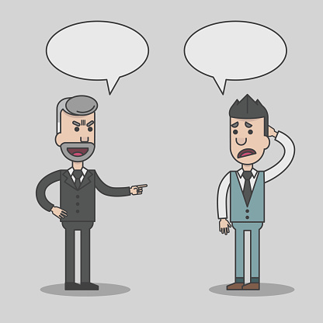
Project Title: Steps to Deal with Angry Customer | Screen Title: Don't Take It Personally | Screen No: 6
 |  | Graphic Info: Animate this picture into the screen while the narrator is speaking. (an illustration of an employee with a thought bubble, separating themselves from the customer's angry expression)
 |  | Navigation: On the bottom of this page, put the arrow button to navigate the course
 |  | Reviewers Comments:
Text/Audio: Handling angry customers can be challenging, and it's natural to feel personally affected by their emotions. However, it's essential to remember that the customer's anger is not directed at you personally. Instead, it is a response to their experience with our product or service. By not taking customer complaints personally, you can maintain a positive and constructive attitude throughout the interaction. Remember, our goal is to find solutions and ensure customer satisfaction. Let's move on to the next step, where we'll explore the importance of using active listening skills.
Your fault….
no

Slide 7

Project Title: Steps to Deal with Angry Customer | Screen Title: Use Active Listening Skills | Screen No: 7
 |  | Graphic Info: Animate this picture into the screen while the narrator is speaking. (image of an employee demonstrating attentive body language and listening intently)
 |  | Navigation: On the bottom of this page, put the arrow button to navigate the course
 |  | Reviewers Comments:
Text/Audio: Active listening is a powerful communication skill that plays a vital role in effectively handling angry customers. It involves more than just hearing; it's about truly understanding the customer's perspective. By practicing active listening, we demonstrate respect for the customer's feelings and create a more open and constructive conversation. Let's move on to the next step, where we'll explore how to actively sympathize with the customer's situation.

Slide 8

Project Title: Steps to Deal with Angry Customer | Screen Title: Actively Sympathize | Screen No: 8
 |  | Graphic Info: Animate this picture into the screen while the narrator is speaking. (image of the employee expressing empathy towards the customer's negative experience)
 |  | Navigation: On the bottom of this page, put the arrow button to navigate the course
 |  | Reviewers Comments:
Text/Audio: Expressing sympathy means acknowledging the customer's negative experience genuinely. Use phrases like 'I'm sorry you had to experience this issue' or 'I understand how frustrating this must be for you. Showing understanding and respect can go a long way in building rapport and creating a more positive customer experience. It reassures the customer that their feelings are valued and that we genuinely care about finding a resolution. Let's proceed to the next step, where we'll explore the importance of offering apologies gracefully.

Slide 9


Project Title: Steps to Deal with Angry Customer | Screen Title: Apologize Gracefully | Screen No: 9
 |  | Graphic Info: Animate this transition into the screen while the narrator is speaking.
 |  | Navigation: On the bottom of this page, put the arrow button to navigate the course
 |  | Reviewers Comments:
Text/Audio: Apologizing sincerely can have a powerful effect on customer satisfaction. It acknowledges any inconvenience they may have faced and shows that we value their feedback. Incorporate phrases like 'I apologize for the inconvenience' or 'I'm sorry for any frustration this has caused' to express remorse and empathy. By apologizing gracefully, we reinforce our commitment to excellent customer service and turn negative experiences into opportunities for resolution. Now, let's move on to the next step, where we'll explore how to find effective solutions to the customer's concerns.
(Visual Transition-illustration of an employee offering a sincere apology to a customer, with a genuine expression)
(Visual Transition 2- an image of the employee taking responsibility for the issue and expressing a desire to find a resolution)

Slide 10
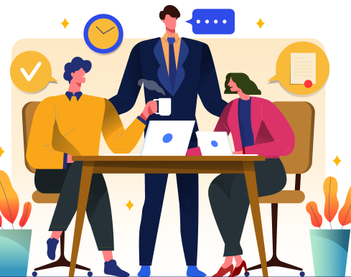
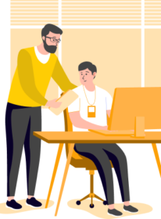
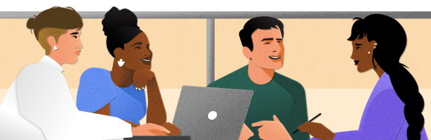
Project Title: Steps to Deal with Angry Customer | Screen Title: Find a Solution | Screen No: 10
 |  | Graphic Info: Animate this picture into the screen while the narrator is speaking. (Visual Transition – Display employee offering alternative solutions with Transition)
 |  | Navigation: On the bottom of this page, put the arrow button to navigate the course
 |  | Reviewers Comments:
Text/Audio: Finding a solution is the ultimate goal when handling customer complaints. By working collaboratively, we can address their concerns effectively and foster greater customer satisfaction. Involve the customer in the resolution process. Listen to their preferences and suggestions. Customers appreciate being heard and being part of finding a solution that best suits their needs. Finding a fair and realistic solution is essential. It demonstrates that we genuinely care about meeting the customer's needs and finding common ground for a positive resolution. Let's proceed to the final step, where we'll discuss the importance of taking a few minutes for yourself after handling tense situations.

Slide 11

Project Title: Steps to Deal with Angry Customer | Screen Title: Customer satisfaction | Screen No: 11
 |  | Graphic Info: Animate this picture into the screen while the narrator is speaking. (image of the employee smiling and thanking the customer)
 |  | Navigation: On the bottom of this page, put the arrow button to navigate the course
 |  | Reviewers Comments:
Text/Audio: As the customer begins to calm down, their body language becomes more relaxed, and they appreciate the efforts made by our employee in addressing their concerns. The positive interaction begins to rebuild trust in the customer-service relationship. We've witnessed how implementing the steps to deal with angry customers effectively can lead to positive outcomes and a more satisfied customer base. Remember, each interaction is an opportunity to build trust and create exceptional customer experiences.

Slide 12

Project Title: Steps to Deal with Angry Customer | Screen Title: Take a Few Minutes on Your Own | Screen No: 12
 |  | Graphic Info: Animate this picture into the screen while the narrator is speaking. (image of the employee interacting with colleagues and sharing a laugh)
 |  | Navigation: On the bottom of this page, put the arrow button to navigate the course
 |  | Reviewers Comments:
Text/Audio: Dealing with angry customers can be stressful, even when the interaction ends positively. It's essential to take a short break after resolving an issue to recharge and take care of yourself. Additionally, talking to colleagues who can bring humor and positive energy can be uplifting. A simple conversation and shared laughter can do wonders for reducing stress.

Slide 13
Conclusion and Objectives
As we conclude this training on 'Steps to Deal with Angry Customer,' let's recap the essential strategies that can help us handle challenging customer interactions effectively,
Handling angry customers requires composure, remaining calm in the face of hostility. Active listening allows us to understand the customer's concerns fully, while active sympathy shows that we care and understand their frustrations.
Apologizing gracefully, regardless of the situation, demonstrates our commitment to resolving issues and improving customer satisfaction.
Working with the customer to find a fair and realistic solution fosters positive customer experiences and strengthens our customer-service relationship.
By successfully handling angry customers, we can rebuild trust and create a positive impact on our customers' overall experience.
Lastly, remember to take a short break after handling tense situations. Self-care is essential for maintaining a positive attitude towards our customers.
By implementing these strategies, we can continue to provide exceptional customer service and create lasting relationships with our valued customers.

Slide 14
ASSESSMENT MCQ
1.What is the role of empathy in handling an angry customer?
To ignore the customer's emotions and focus on the solution.
To dismiss the customer's feelings as irrelevant.
To use empathetic language and understand the customer's perspective.
To tell the customer that their anger is unnecessary
Answer: c) To use empathetic language and understand the customer's perspective.
2.What is the recommended approach when dealing with an upset customer?
Interrupt the customer and provide solutions immediately.
Patience and active listening to allow the customer to express their grievances.
Avoid apologizing as it may escalate the situation.
disinterest in the customer's concerns to prevent further complaints.
Answer: b) Patience and active listening to allow the customer to express their grievances

Slide 15
PowerPoint Presentation Summary:
The presentation comprises 13 slides, each focusing on a specific step to deal with angry customers.
Visual graphics complement the content, making the presentation engaging and memorable.
Assessment guide for clarity.
The presentation aims to equip employees with essential strategies for managing tense customer situations effectively.

Slide 16
THANKS!
Any questions?
You can find me at @supriyaparida485@gmail.com

